Slide 1
BADMINTON ANAYTICS

Slide 2
CONTENTS
Introduction
Data Exploration
Model Building
Business Aspect
Further improvements

Slide 3
Introduction
The real game badminton data is collected manually. The data consists of various features like no.of errors I made , my hydration status, whether I meditated or not etc.
All these features in a way directly or indirectly affects the outcome of the game.
The data perfectly fits for a supervised classification problem wherein we can apply various Machine Learning algorithms to predict the outcome or chances of winning a game given the data of several previous games. Also we can do exploratory data analysis and find valuable insights that might help a player improve his game.

Slide 4
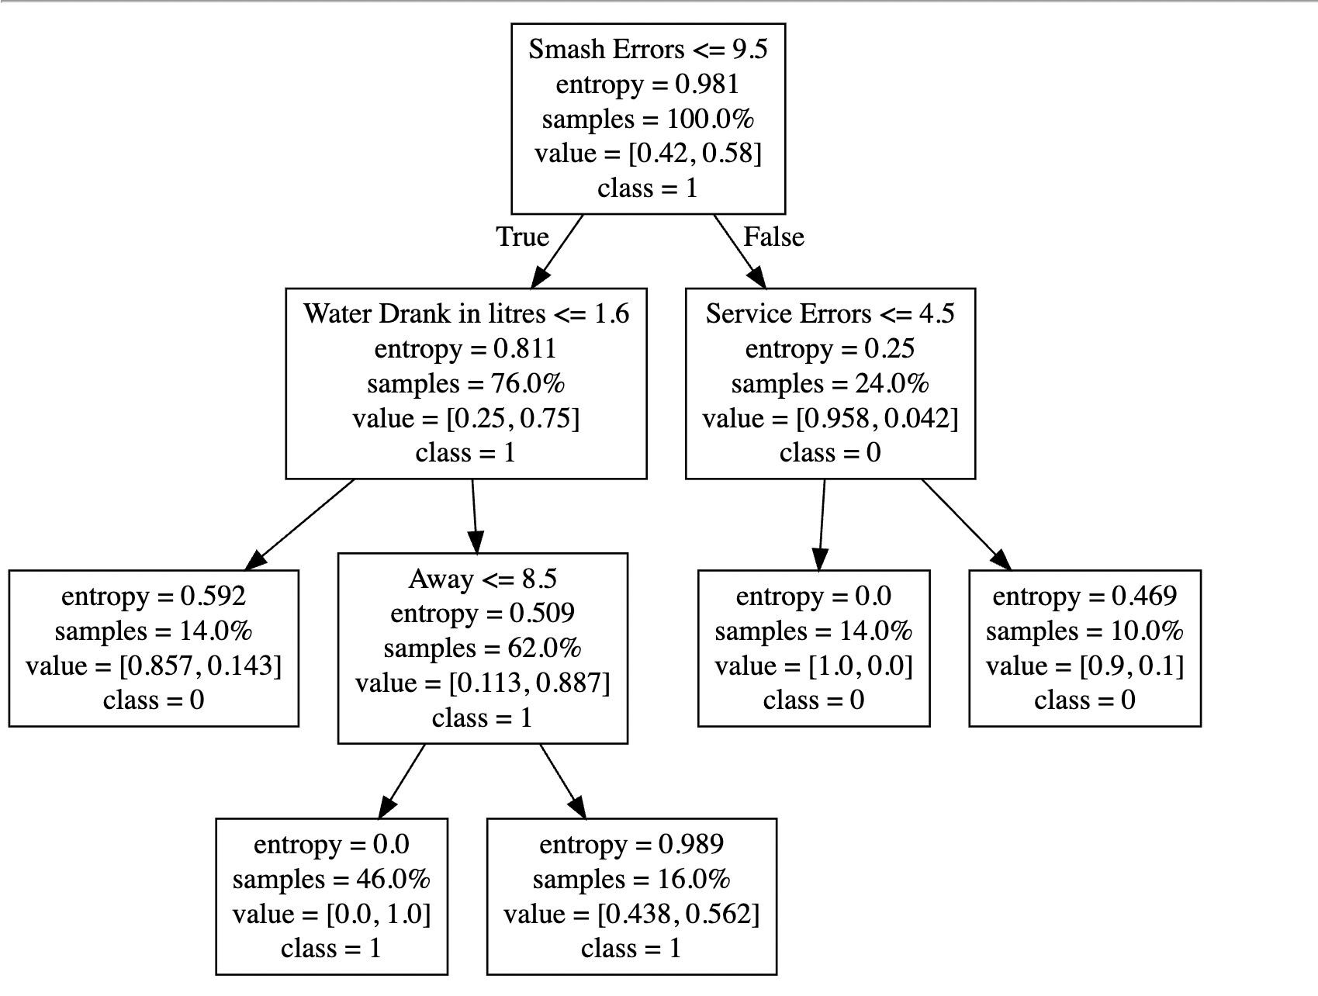
Decision Tree

Slide 5
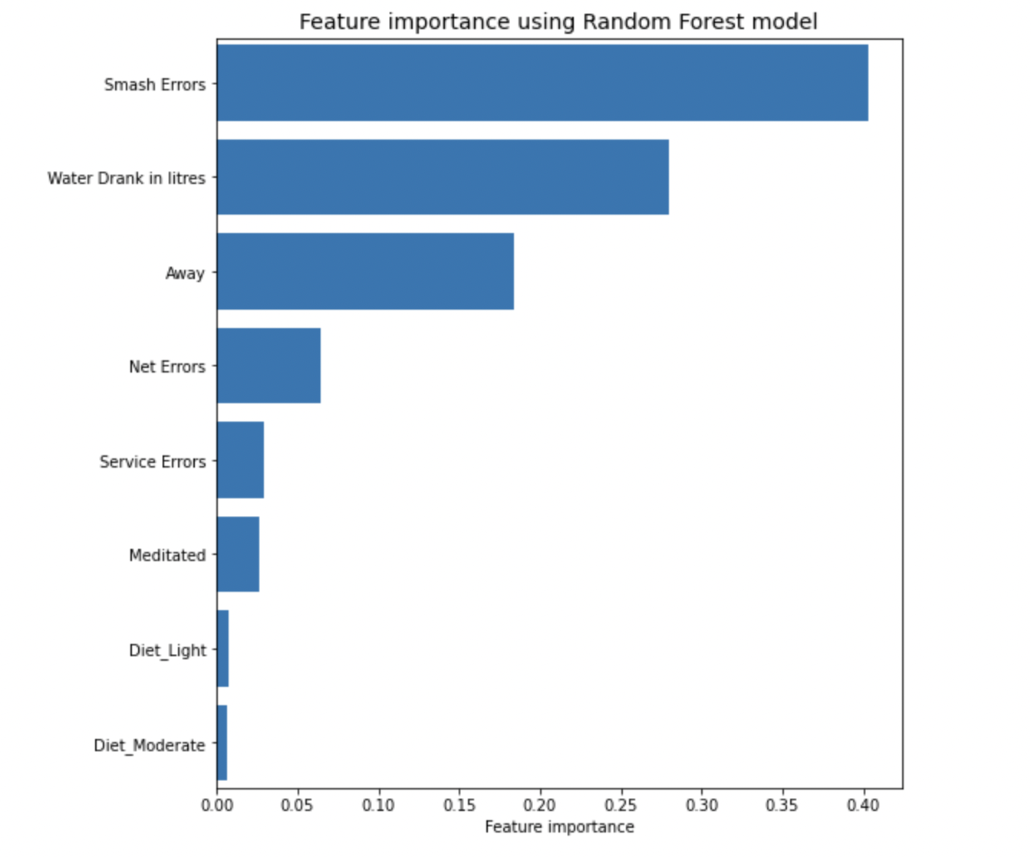
Feature Importance using Random Forest

Slide 6
Business Aspect
There are two possible domains that might use the predictive model that we built.
Let’s say there is a betting company like dream11. The company can provide to its premium customers the probability score of a particular player winning the game and the customers might consider the probability score before betting on a particular player.
Let’s say there is a player who wishes to improve his game. There might be several factors that he should work on. But of all the several factors which are all to be given the top most priority? In comes the feature importance technique wherein the player must focus on the top most features provided by it.

Slide 7
Potential Directions For Future Work
The data is collected manually. So it is easy if there are only few games. But if there are many games then it becomes difficult to collect the data manually. Also there is a chance of human error.
So the better way of collecting data would be to take the video of the entire game, pre-process it and then apply action recognition using deep learning

